Slide 1
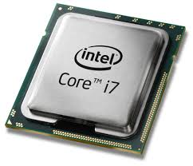
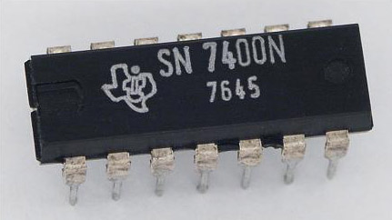
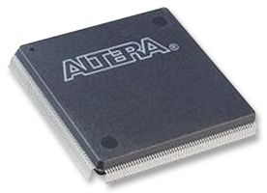
Any logic function
Any processing unit
FPGA

Slide 2
CNENGR 228
Digital Electronics
Lecture 1 – Course Introduction &
Digital System Design Strategies
Dr Zhongming Zhang
School of Engineering
Lancaster University

Slide 3
Course Objectives
Hardware: Get familiar with the architecture. Understand and explore the benefits and the limitations of FPGAs.
Software: Learn to use Electronic Design Automation (EDA) Tools in digital design.
Programming Language: Get familiar with VHDL design methods (constructs and syntaxes). Understand the digital design flow for FPGA boards.

Slide 4
About this module
10-week module
  1x 2 hour lecture/fortnight
  1x 2 hour practical/week
  1x 2 hour tutorial/fortnight
  Assessments
  7 x practical exercises (6% each), assessed via seven Moodle Quizzes
  1x class test (40%), TBC
  1 x coursework (18%) – Design project using the Altera FPGA board,

Slide 5
About this module
Prerequisites: CNENGR 116 Fundamentals of Digital Electronics
Xunzi
I hear and I forget.
I see and I remember.
I do and I understand.

Slide 6
What I expect from you
Come to lectures and practical labs
Complete assessments on time
Interact in class – ask and answer questions
Understand, no need to memorise
Apply yourselves
Become interested and do private study
Limit the time you spend on your phone in class, unless you are supplementing your learning

Slide 7

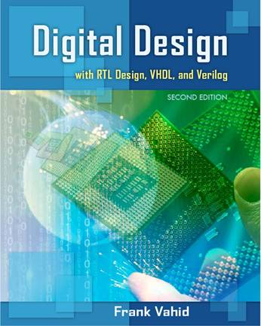
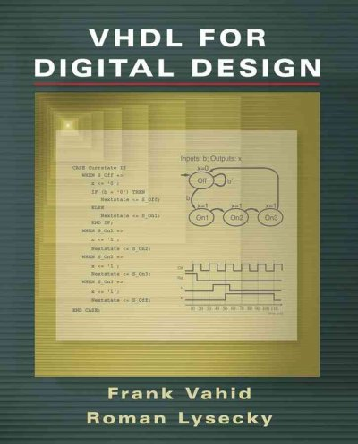
Recommended Reading List
William Kleitz,
9th Edition, 2014
Frank Vahid,
2nd Edition, 2011
Frank Vahid,
2007
(Altera based product)

Slide 8

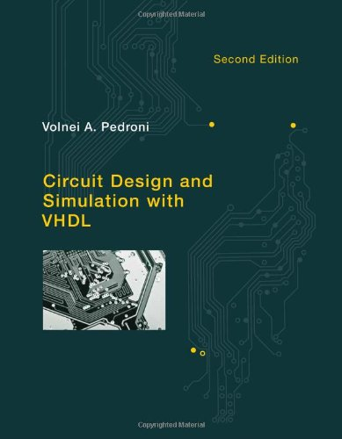
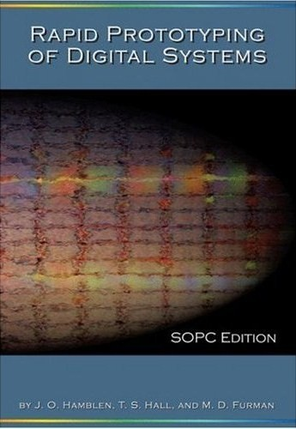
Recommended Reading List
Pong P. Chu,
2006
V. A. Pedroni,
2nd Edition, 2010
James O. Hamblen,
2008
(Altera based product)
(Altera based product)

Slide 9
So, on to today’s lecture….
Digital System Design Strategies

Slide 10
Objectives
  Recognize different digital system design techniques
  Understand the structure of programmable logic devices (PLDs)
  Identify the differences of PLDs

Slide 11
From Design to Implementation
Different IC types
  Some fast but expensive
  Others cheaper but slower
(
a
)
Belt
W
a
r
n
k
p
w
s
(
c
)
(
b
)
FPGA company
ASIC
Custom
IC
FPGA
Notes:
Common design flows for different IC types:
Digital designers first create a desired circuit
Some IC types, like full-custom ICs or ASICs, involve manufacturing a new IC, requiring millions of dollars and many months
A programmable IC type is pre-made and available off-the-shelf, costing tens of dollars and requiring just minutes, but resulting in bigger and slower circuit implementations.
Introduce dark room motion sensor

Slide 12
1. Digital System Design Strategies
How many different digital design techniques have you practiced in your previous modules?
  Boolean Logic: minimal sums, products, don't care
  Circuit Levels or Layers
  Karnaugh Maps
  Multiple Output Simplification
  State Diagrams, Tables (Mealy and Moore)
  Implication Tables to find Equivalent States
  Minimal State Tables
  Unused State Analysis
  State Assignment Techniques
  Excitation Tables
  Algorithmic State machines (Mealy and Moore)
  Flow Tables and their Reduction
  Races

Slide 13
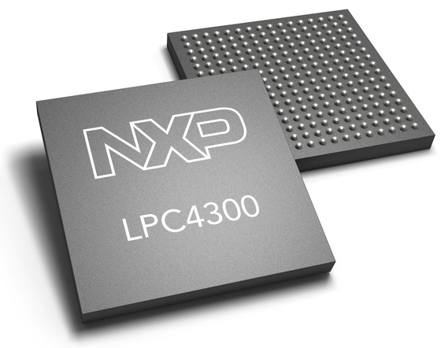
1.1. Microprocessors, Microcontrollers
Processors
  Sophisticated state machines
  Fixed function devices
  Executing programs
Inputs: x; Outputs: z
x
MPUs,
MCUs
x
x
SB
x’
x’
SI
SA
SH
z=1
SO
x
x’
z=1
z=0
x
z=0
x
z=0
x’
x
x
x’
x'
x’
SC
x’
SD
x’
SG
SJ
x’
SM
z=0
z=1
z=0
x’
z=0
z=1
x
x
x
x’
x’
x
x’
x
SK
SE
SL
SN
z=0
SF
z=1
x
z=0
x
z=1
x’
z=1
Notes:
Think about an in the dark motion sensor, the detector is the digital system (discuss)
MPU – Microprocessor unit is an IC which has only a Central Processing Unit (CPU)
MCU – Microcontroller unit has an IC (like a MPU) as well as ROM, RAM and other peripherals on the same chip
MPU differ in performance, cost, power and other metrics.
MPU – Good option
readily available
inexpensive
easy to program
easy to reprogram
MPU – the limit (aren’t good enough)
too slow (one or few instructions at a time), custom digital circuits can execute hundreds or thousands of computations in parallel
too big
consume too much power
too costly

Slide 14
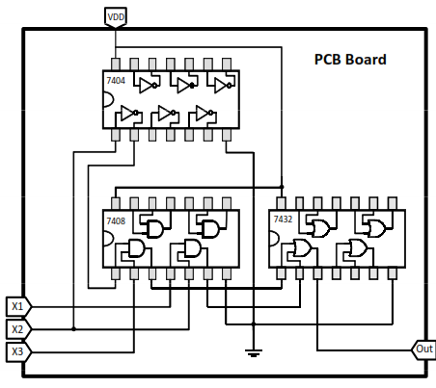
1.2. Conventional Approach
Board-based design
  Large number of ICs on a single printed circuit board (PCB)

Slide 15
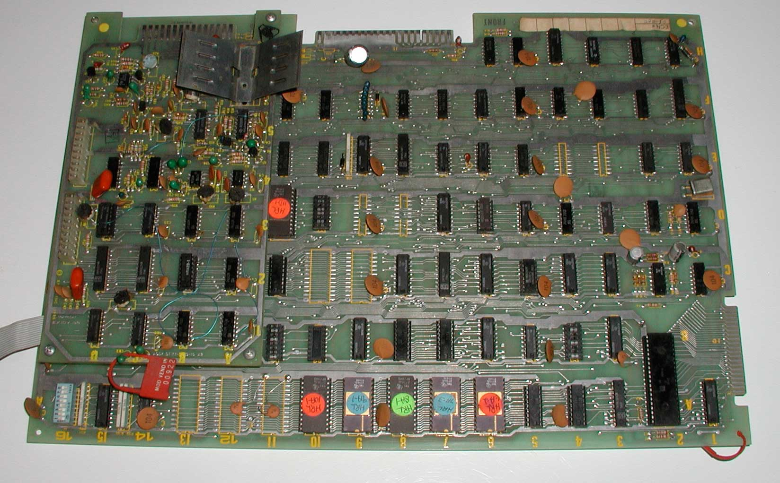
1.2. Conventional Approach
Off-the-shelf fixed function logic gates
VCC
I
14
I
13
I
12
I
11
I
10
I
9
I
8
I
C
I
1
I
2
I
3
I
4
I
5
I
6
I
7
GND

Slide 16
1.3. High-Density Single Chip
A single chip replaces the whole multi-chip design on PCB
Either using (A) Programmable Logic Devices (PLDs)
Or (B) Application Specific Integrated Circuits (ASICs)
  Lower overall cost
  On-chip interconnects are many times faster than off-chip wires
  Lower area with the same functionality
  Lower power consumption
  Lower noise

Slide 17
Summary of Design Strategies
Microprocessors (software-based)
  Fetch and execute software instructions
  Slow
  Power hungry
Programmable Logic Devices (PLDs) (hardware-based)
  Directly implements logic functions on hardware
  Faster
  Less power consumption
Application Specific Integrated Circuits (ASIC) (hardware-based)
  Fastest
  Lowest power consumption
Course focus

Slide 18
2. Programmable Logic Devices (PLDs)
Digital IC
PLDs
ASIC
SPLD
CPLD
FPGA
Semi-Custom
Full-Custom
PLA
PAL
Standard Cell
Gate Array
Notes:
Programmable Logic Devices (PLDs)
Simple Programmable Logic Device (SPLD)
Programmable Array Logic (PAL)
Programmable Logic Array (PLA)
Complex Programmable Logic Device (CPLD)
Field Programmable Gate Array (FPGA)

Slide 19
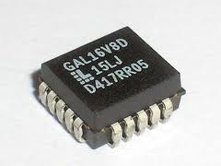
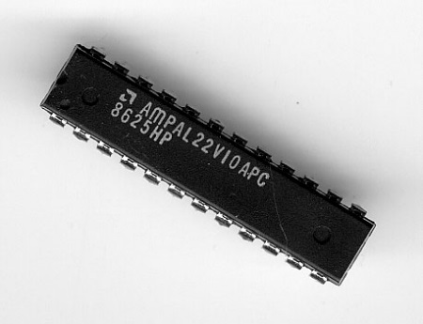
2. Programmable Logic Device (PLD)
Off-the-Shelf PLD - user configurable ICs that will be programmed to perform specific logic operation
  Contains thousands of basic logic gates in a single package
  Implementation is faster and cheaper than equivalent fixed-logic designs
  Design can be readily changed without rewiring
  Reduce the amount of area on a printed circuit board
Simple Programmable Logic Device

Slide 20
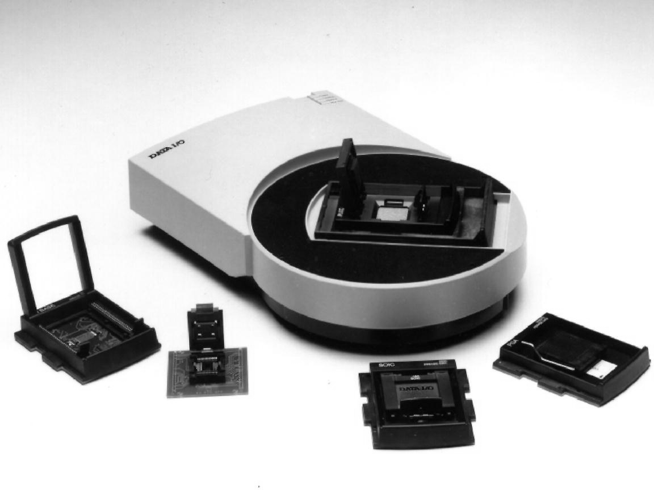
2. Programmable Logic Device (PLD)
A PLD programming unit (courtesy of Data IO Corp)

Slide 21
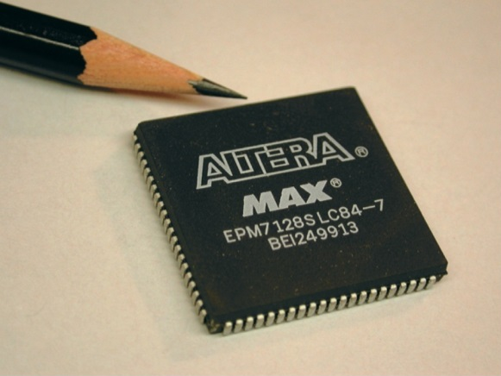
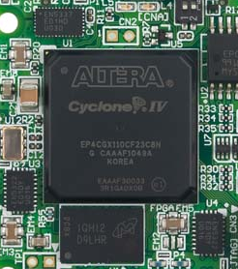
2. Programmable Logic Device (PLD)
List of Abbreviations
  SPLDs - Simple Programmable Logic Devices
    PAL - Programmable Array Logic
    PLA - Programmable Logic Array
    GAL - Generic Array Logic
  CPLDs - Complex Programmable Logic Devices
  FPGAs - Field Programmable Gate Arrays
  ASIC - Application Specific Integrated Circuits
CPLD
FPGA

Slide 22
2. Programmable Logic Devices (PLDs)
Digital IC
PLDs
ASIC
SPLD
CPLD
FPGA
Semi-Custom
Full-Custom
PLA
PAL
Standard Cell
Gate Array

Slide 23
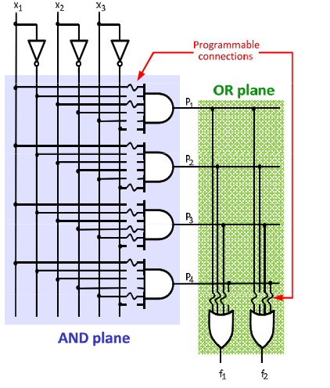
2.1. Programmable Logic Array (PLA)
Consists of two levels of logic gates
  Programmable wired AND-gates
  Programmable wired OR-gates
Advantages
  Efficient in terms of the required area
Drawbacks
  Difficult to fabricate
  Significant propagation delay
  Normally large packages thus high fabrication cost

Slide 24
2.2. PLA Architecture
I1
I2
I3
Programmable node
Fuse based – “blown” fuse removes connection
Programmable nodes
Fuse
O1
“unblown” fuse
“blown” fuse
Memory based - 1 creates connection
Configuration bit
storage cell
storage cell
PLD IC
1
0
Generic Array Logic (GAL) is PLA that can be reprogrammed many times.

Slide 25



2.3. PLA single-line notation
x1
x2
x3
$$F$$
Example: Implement the function
on the given PLA
Well-suited for implementing functions in sum-of-product (SOP) form
$$F=x_{1}x_{2}+x_{1}x_{3}+x_{1}x_{2}x_{3}′$$
×
×
×
×
×
×
×
×
×
×
PLA IC
$$F$$
O1
O2

Slide 26
2. Programmable Logic Devices (PLDs)
Digital IC
PLDs
ASIC
SPLD
CPLD
FPGA
Semi-Custom
Full-Custom
PLA
PAL
Standard Cell
Gate Array

Slide 27

2.4. Programmable Array Logic (PAL)
Most basic and least expensive
  Programmable wired AND-gates
  Fixed wired OR-gates
Advantages
  Simpler fabricate
  Better performance
Drawbacks
  Less flexibility
Example: implementing any 3-input function of up to 3 terms
x1
x2
x3
wired AND
×
×
O1
×
×
×
O2
$$F=x_{1}x_{2}x_{3}+x_{1}′x_{3}′$$
PLD
IC

Slide 28
2.4. PAL Architecture
Extra circuitry added to output of OR-gate
Used to connect/disconnect the output pins
Allows flip-flop bypass
Select
Enable
O
1
Flip-flop
D
Q
Clock
For implementation of circuits that have multiple stages of logic gates
To AND plane
Notes:
REMEMBER : D flip-flop acts as memory, i.e. outputs the value on D when the clock is high, output Q remains unchanged until input D changes AND clock transitions high or is already high.
‘Select’ gives choice of asynchronous or synchronous circuit.

Slide 29
2.4. PAL Architecture
Two-output PAL
PAL with programmable registered outputs
I
1
I
2
I
3
wired AND
I
1
I
2
I
3
programmable bits
0/1
O1
0/1
O1
×
×
×
×
D
Q
×
×
×
×
×
×
×
×
0/1
O2
0/1
O2
D
Q
PLD
IC
clk
PLD IC

Slide 30
2. Programmable Logic Devices (PLDs)
Digital IC
PLDs
ASIC
SPLD
CPLD
FPGA
Semi-Custom
Full-Custom
PLA
PAL
Standard Cell
Gate Array

Slide 31
2.5. Complex PLDs
Complex Programmable Logic Device (CPLD)
  Combines several PAL-type SPLDs into a single package
  Non-volatile – memory is not lost when power is removed
  Can be repeatedly programmed to implement different functions
I/O block
PAL-like
PAL-like
I/O block
block
block
Interconnection wires
I/O block
PAL-like
PAL-like
I/O block
block
block

Slide 32
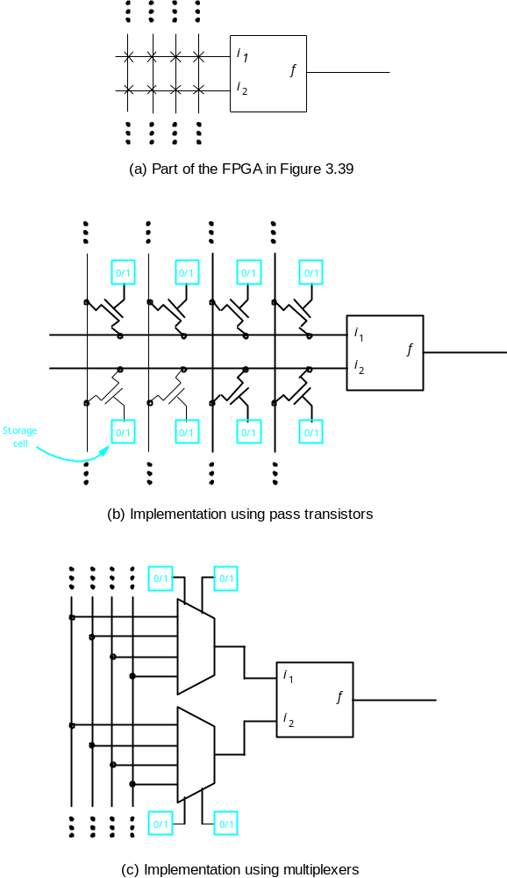
2.5. Complex PLDs
A Section of CPLD
  Easy to reprogram even in the system
  High speed implementation
PAL-like block (details not shown)
PAL-like block
0/1
0/1
0/1
0/1
D
Q
D
Q
0/1
0/1
0/1
0/1
storage
cell
D
Q

Slide 33
IC Tradeoffs, Trends and Comparisons
*Non-recurring engineering
Off-the-shelf
Manufactured
FPGA
Full-custom
Logic
IC
SPLD/CPLD
Standard cell ASIC
Programmable
Gate array (structured ASIC)
Easier design
Quicker availability
0
0
1
6
12
(months)
Lower NRE* cost
0
0
1
50
150
(M$)
Faster performance
0.05
0.5
1
3
5
(GHz)
Smaller size
200
100
10
4
1
(sq mm)
More optimized
Lower power
10
5
0.1
0.05
0.01
(W)
L
o
w
er unit cost
20
20
3
1
0.5
($)
More capacity
0.001
0.1
0.5
1
2
(B gates)
Sample values
Notes:
When designing a digital circuit, physically implementing a circuit on an IC presents designers with numerous trade-offs among design metrics – Performance, size, power, cost and time to availability.
Fig. Trade-offs among various IC types. Sample values for various metrics are also shown. E.g. Performance for an SPLD/CPLD might be 0.05 GHz, but 3 GHz for a standard cell ASIC. Actual values can vary from those shown.

Slide 34
IC Tradeoffs, Trends and Comparisons
*Non-recurring engineering
 | SPLD/CPLD | FPGA | Gate array (structured ASIC) | Standard cell ASIC | Full-custom
Quicker availability | 0 | 0 | 1 | 6 | 12 | Months
Lower NRE* cost | 0 | 0 | 1 | 50 | 150 | M$
Faster performance | 0.05 | 0.5 | 1 | 3 | 5 | GHz
Smaller size | 200 | 100 | 10 | 4 | 1 | Sq mm
Lower power | 10 | 5 | 0.1 | 0.05 | 0.01 | W
Lower unit cost | 20 | 20 | 3 | 1 | 0.5 | $
More capacity | 0.001 | 0.1 | 0.5 | 1 | 2 | B gates

Slide 35
Choose an IC Type for Each Project
Project A involves putting the circuit into 100 million mobile phones; encryption speed must be 2.5 GHz, and each chip can be priced up to $5.
Project B involves putting the circuit into 10,000 medical devices; encryption speed must be 1 MHz, and each chip can be priced up to $50.
Project C involves putting the circuit into 100,000 automobiles; encryption speed must be 10 MHz, and each chip can be priced up to 10$.
(Choose from among standard cell ASIC, gate array, or FPGA IC types only, use metric values from previous slide.)
Standard cell ASICs
FPGAs
Gate array (nearest)
Notes:
t)

Slide 36
Summary
Introduced a range of different digital design strategies: Microcontroller, PLDs, ASICs.
Get familiar with different programmable logic devices, PLA, PAL, CPLD.
Understanding the architecture of different PLDs

Slide 37
FPGAs vs. ASIC
ASIC Application Specific Integrated Circuit | FPGA Field Programmable Gate Array
Designed all the way from behavioral description to physical layout. | No physical layout design; design ends with a bitstream used to configure a device.
Designs must be sent for expensive and time consuming fabrication in semiconductor foundry. | Bought off-the-shelf and reconfigured by designers themselves.

Slide 38
FPGAs vs. ASIC
FPGAs
Which way to go?
Off-the-shelf
ASICs
High Performance
Low development cost
Low power
Short time to market
Low cost in
high volumes
Reconfigurability

Slide 39
Configuration Cell Technologies
* One-time programmable
Configuration Technology | Symbol | Application
Fusible-link |  | SPLDs
Antifuse (OTP*) |  | Some FPGAs
Flash |  | SPLDs, CPLDs, and some FPGAs
SRAM |  | Most FPGAs and some CPLDs
Flash-SRAM Hybrid |  | Some FPGA
SRAM
SRAM
Notes:
One-time programmable (OTP) memory is a type of non-volatile memory (NVM) that commonly comprises of electrical fuse (eFuse) and antifuse. The advantages of OTP memory over multi-time programmable (MTP) memory, such as EEPROM or flash memory, are smaller area and no additional wafer processing steps. Therefore, for many low-cost applications, the OTP memory is used to replace the MTP memory.

Slide 40
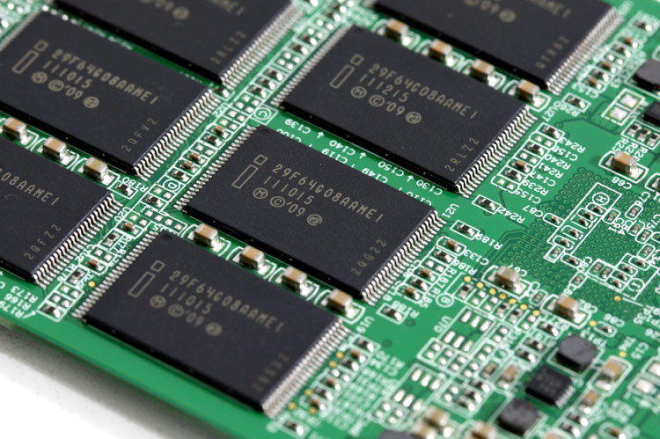
Memory Devices
RAM
SRAM
  Fast, Lower power
  Volatile
DRAM
  Slower, Compact
  Cheaper
ROM
Masked-programmed ROM
One-Time Programmable (OTP) ROM
EPROM, EEPROM, Flash Memory

